Slide 1

Angular 11 - Notes
www.codehafeez.com

Slide 2
Angular Basic
Develop by Google
Single Page Application
It is based on MVC

Slide 3
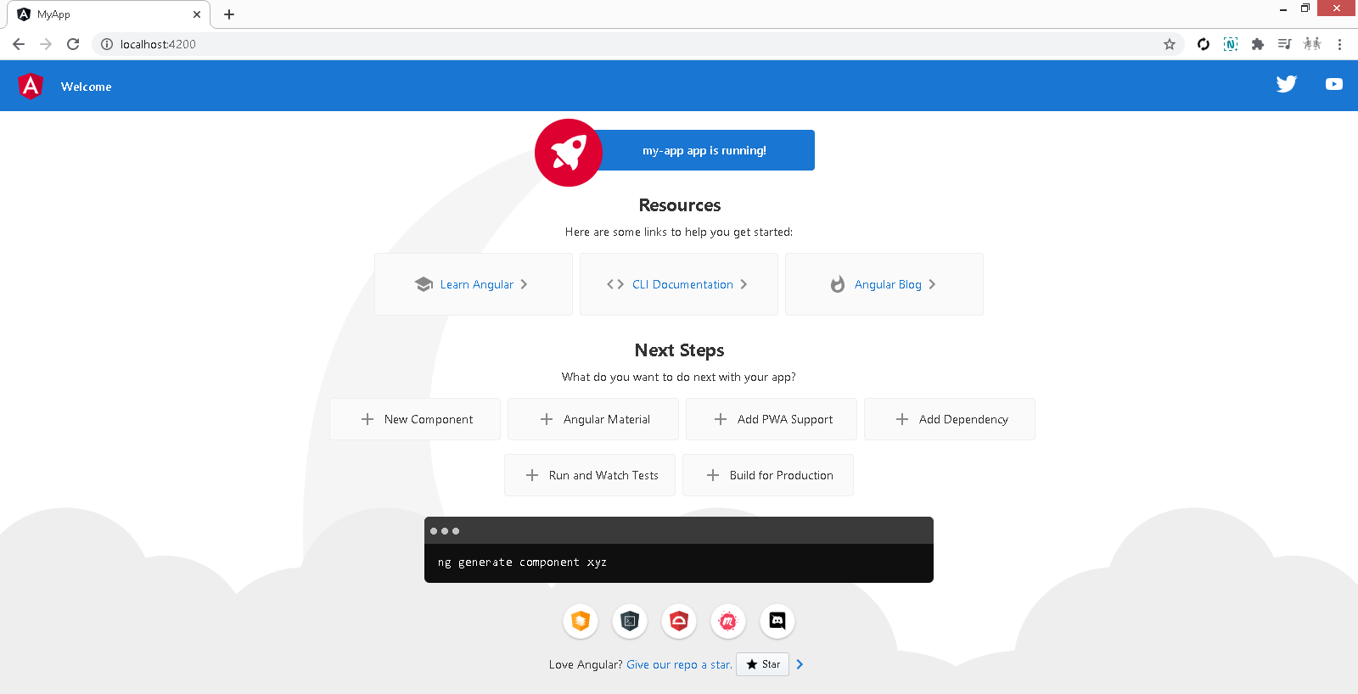
Angular Install
Install Node JS
npm install -g @angular/cli
ng new my-app
cd my-app
ng serve
ng g c userList // create page
ng g m users // create module

Slide 4
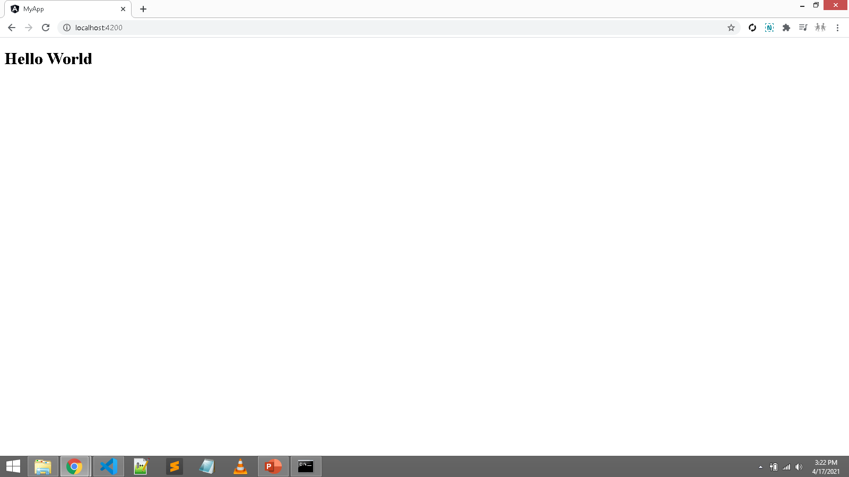
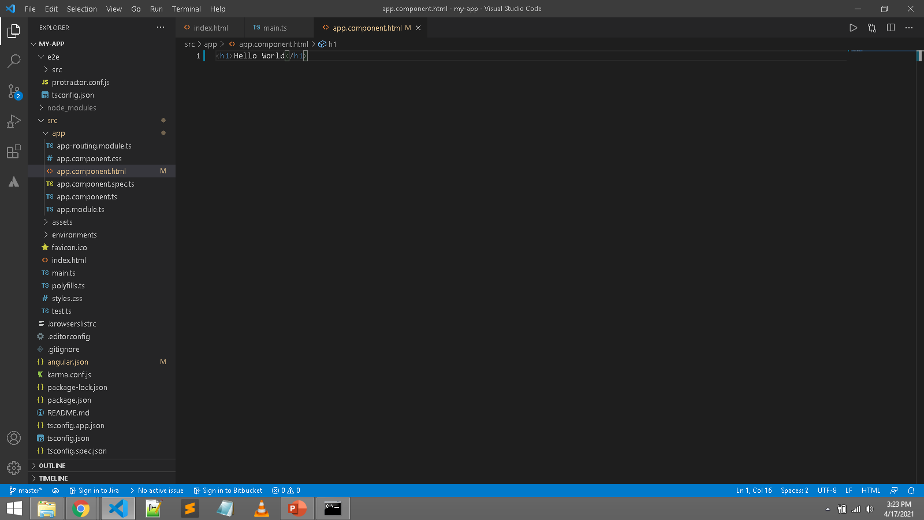
my-app\src\app\ app.component.html

Slide 5
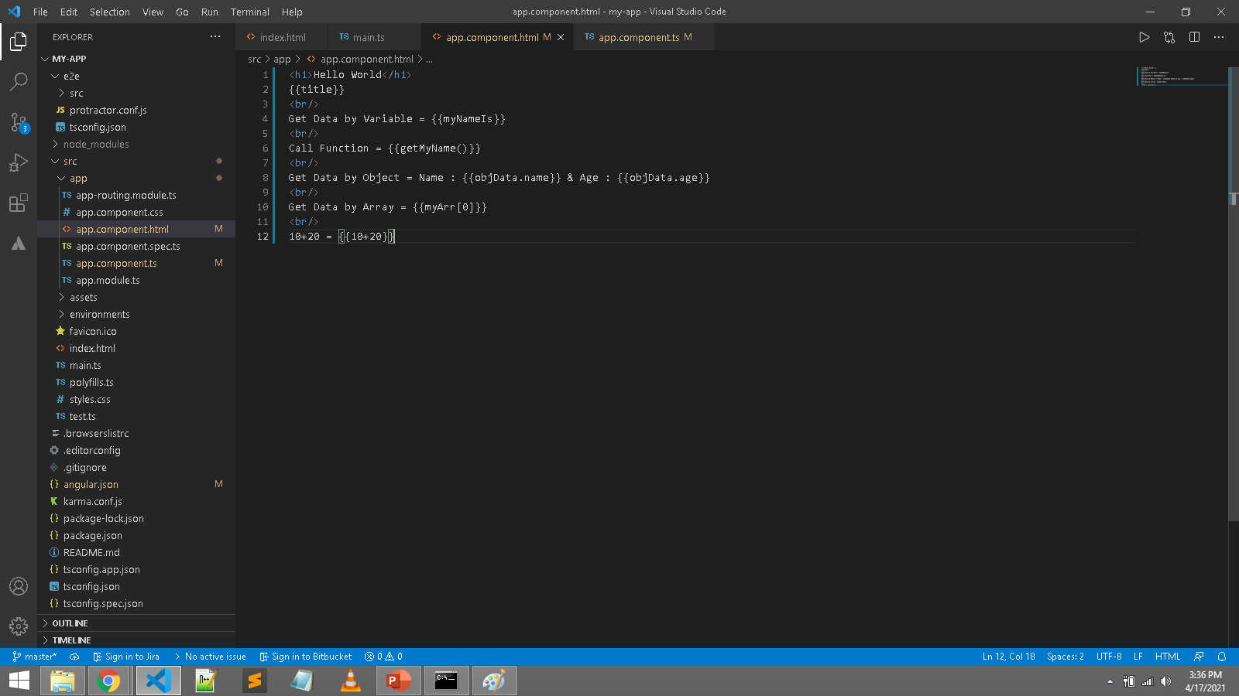
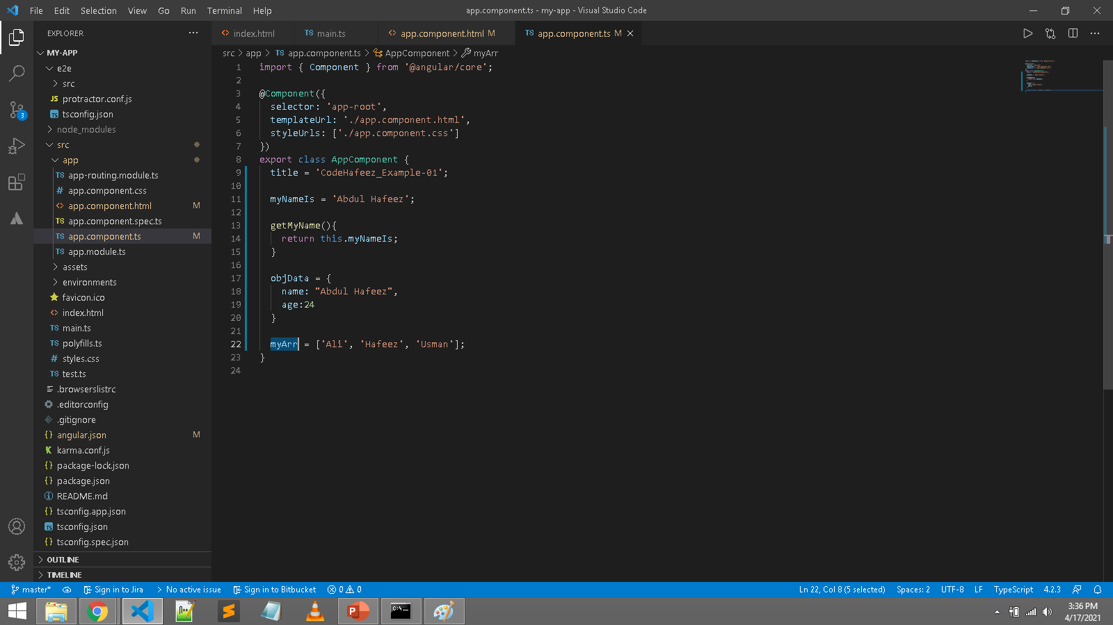
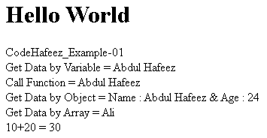
my-app\src\app\ app.component.html my-app\src\app\ app.component.js

Slide 6
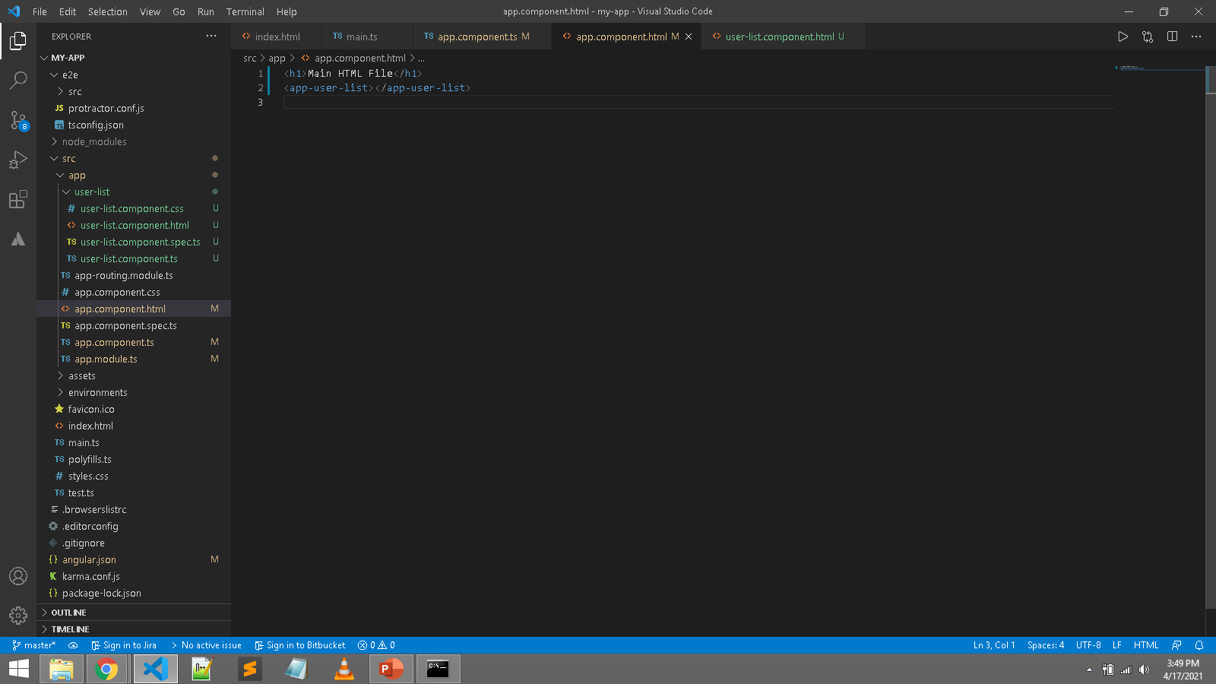
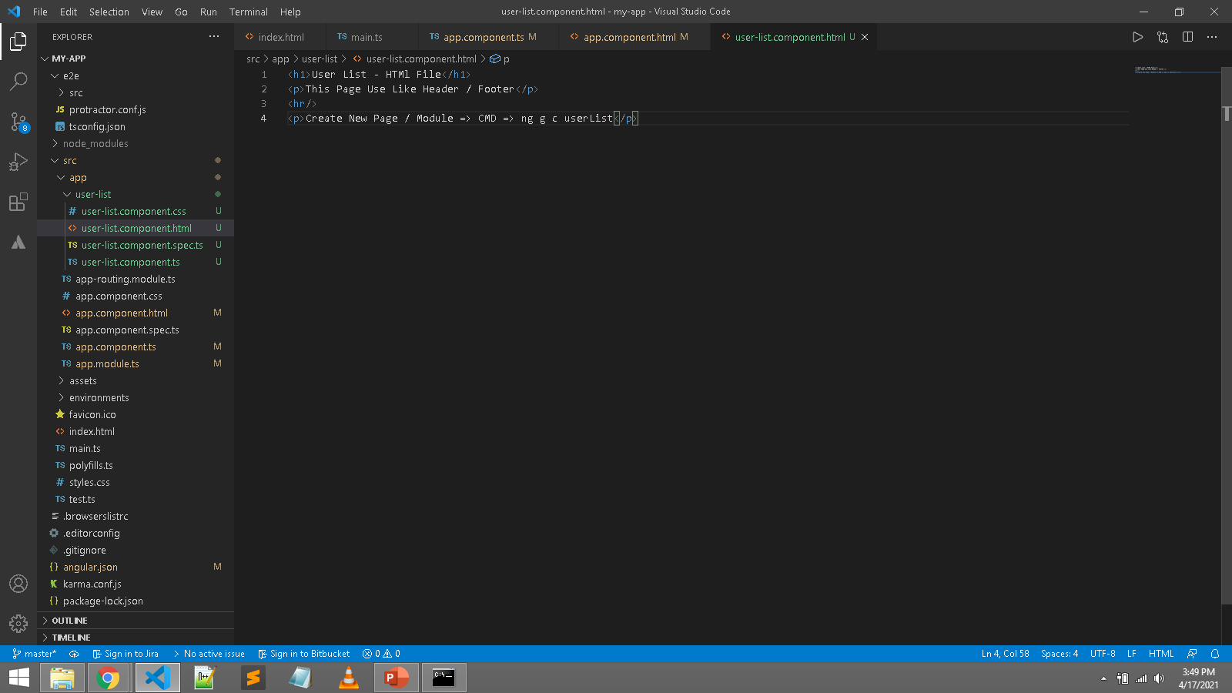
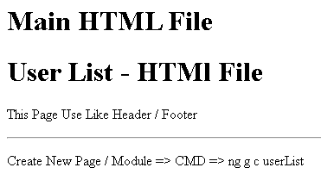
Create New Page Like Header / Footer
ng g c userList

Slide 7
Module within Component

Slide 8
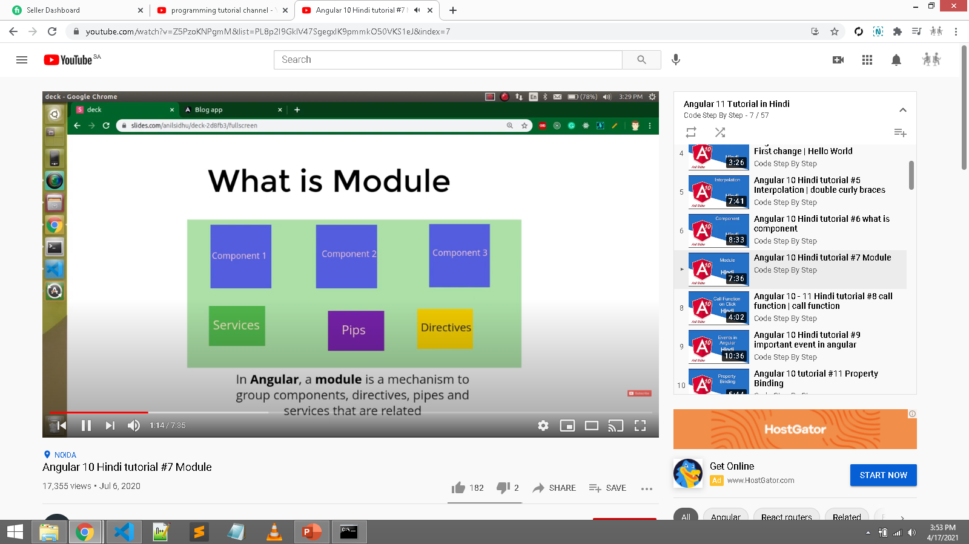
Module => Collection of components
CMD create module => ng g m users

Slide 9
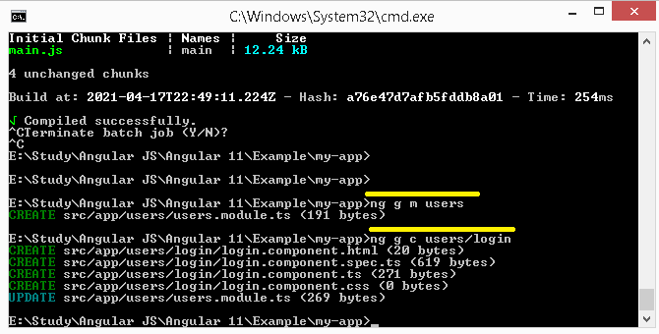
Create Module and component within module
ng g m users
ng g c users/login

Slide 10
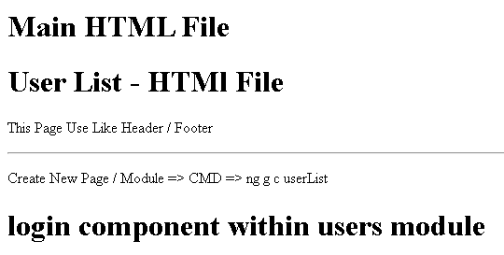
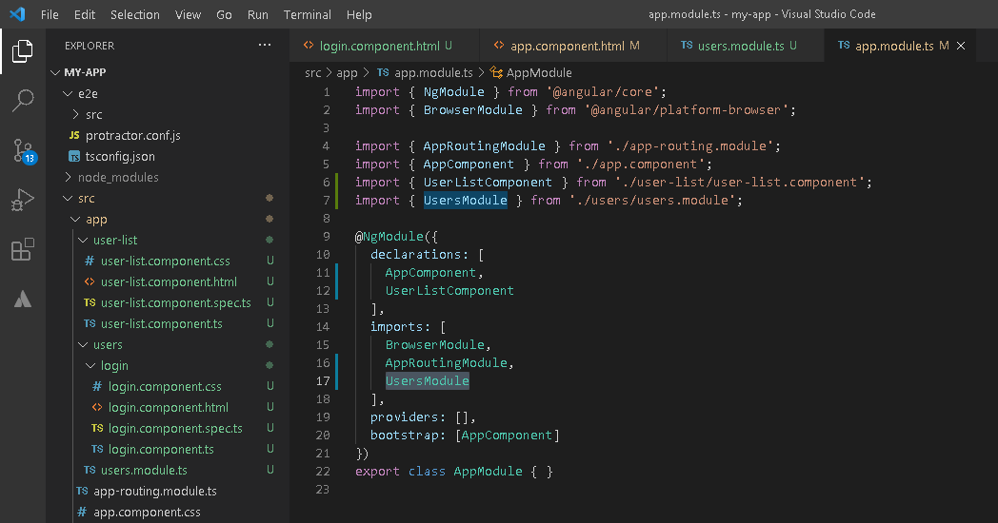
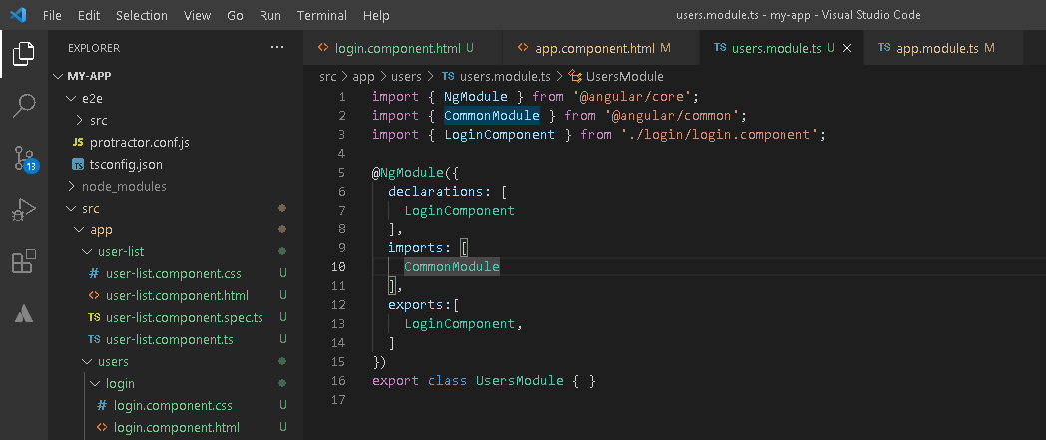
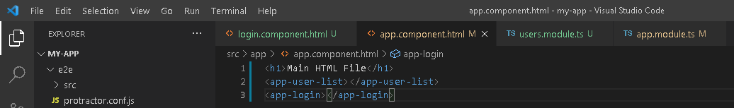

Module within Component

Slide 11
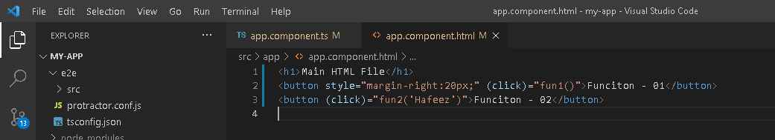
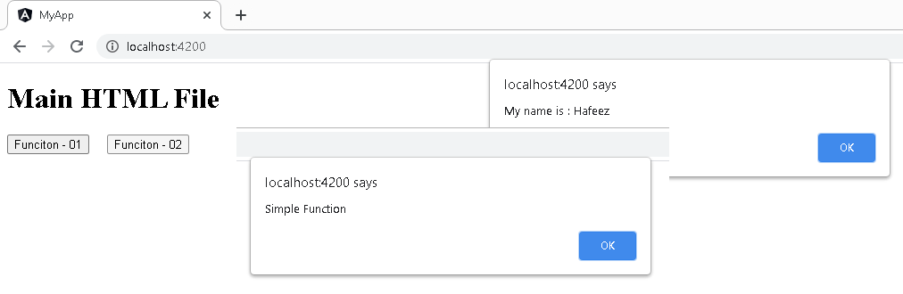
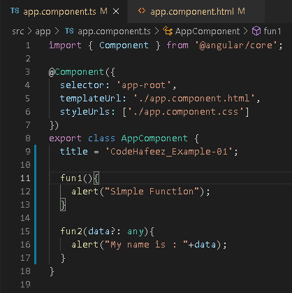
Function

Slide 12
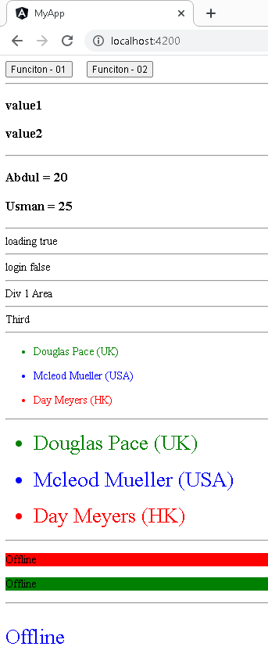
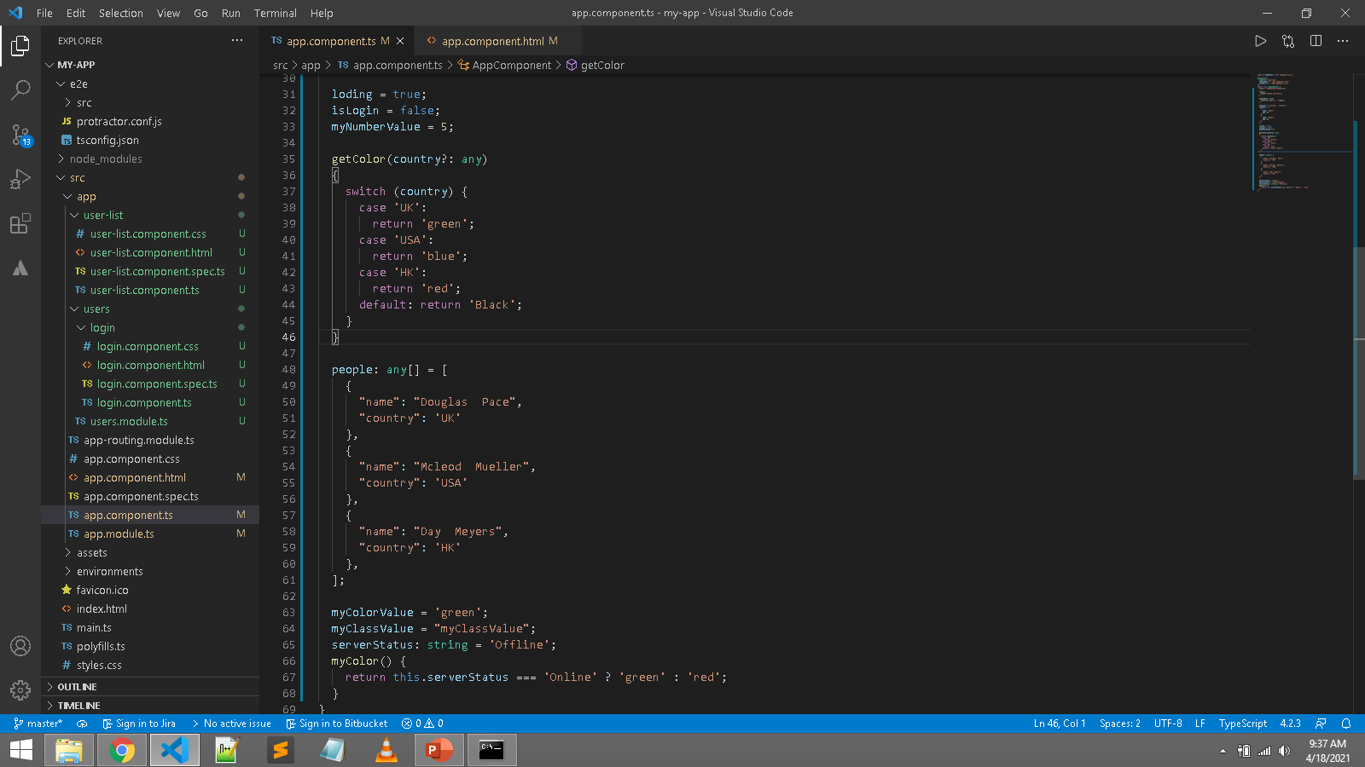
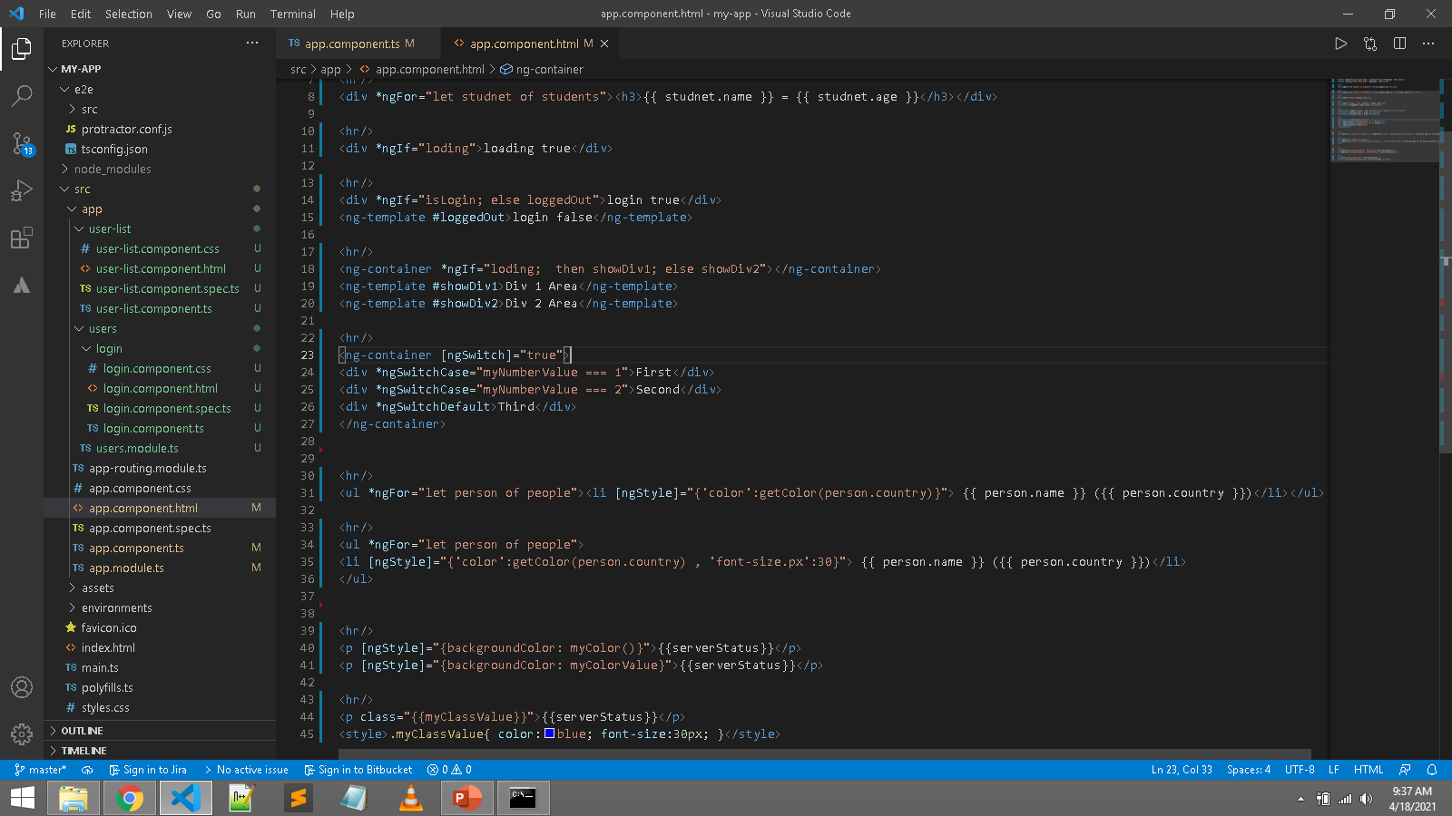
IF, Else, Loop, Switch, Dynamic (Style & Class)

Slide 13
IF, Else, Loop, Switch, Dynamic (Style & Class)
<button style="margin-right:20px;" (click)="fun1()">Funciton - 01</button>
<button (click)="fun2('test-msg')">Funciton - 02</button>
<hr/>
<div *ngFor="let product of products"><h3>{{ product }}</h3></div>
<hr/>
<div *ngFor="let studnet of students"><h3>{{ studnet.name }} = {{ studnet.age }}</h3></div>
<hr/>
<div *ngIf="loding">loading true</div>
<hr/>
<div *ngIf="isLogin; else loggedOut">login true</div>
<ng-template #loggedOut>login false</ng-template>
<hr/>
<ng-container *ngIf="loding; then showDiv1; else showDiv2"></ng-container>
<ng-template #showDiv1>Div 1 Area</ng-template>
<ng-template #showDiv2>Div 2 Area</ng-template>
<hr/>
<ng-container [ngSwitch]="true">
<div *ngSwitchCase="myNumberValue === 1">First</div>
<div *ngSwitchCase="myNumberValue === 2">Second</div>
<div *ngSwitchDefault>Third</div>
</ng-container>
<hr/>
<ul *ngFor="let person of people"><li [ngStyle]="{'color':getColor(person.country)}"> {{ person.name }} ({{ person.country }})</li></ul>
<hr/>
<ul *ngFor="let person of people">
<li [ngStyle]="{'color':getColor(person.country) , 'font-size.px':30}"> {{ person.name }} ({{ person.country }})</li>
</ul>
<hr/>
<p [ngStyle]="{backgroundColor: myColor()}">{{serverStatus}}</p>
<p [ngStyle]="{backgroundColor: myColorValue}">{{serverStatus}}</p>
<hr/>
<p class="{{myClassValue}}">{{serverStatus}}</p>
<style>.myClassValue{ color:blue; font-size:30px; }</style>
import { Component } from '@angular/core';
@Component({
selector: 'app-root',
templateUrl: './app.component.html',
styleUrls: ['./app.component.css']
})
export class AppComponent {
title = 'CodeHafeez_Example-01';
fun1(){
alert("Simple Function");
}
fun2(data?: any){
alert("My name is : "+data);
}
products = ['value1', 'value2'];
students = [
{
name: "Abdul",
age: 20
},
{
name: "Usman",
age: 25
}
];
loding = true;
isLogin = false;
myNumberValue = 5;
getColor(country?: any)
{
switch (country) {
case 'UK':
return 'green';
case 'USA':
return 'blue';
case 'HK':
return 'red';
default: return 'Black';
}
}
people: any[] = [
{
"name": "Douglas Pace",
"country": 'UK'
},
{
"name": "Mcleod Mueller",
"country": 'USA'
},
{
"name": "Day Meyers",
"country": 'HK'
},
];
myColorValue = 'green';
myClassValue = "myClassValue";
serverStatus: string = 'Offline';
myColor() {
return this.serverStatus === 'Online' ? 'green' : 'red';
}
}

Slide 14
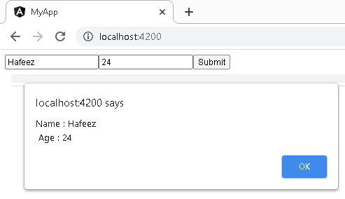
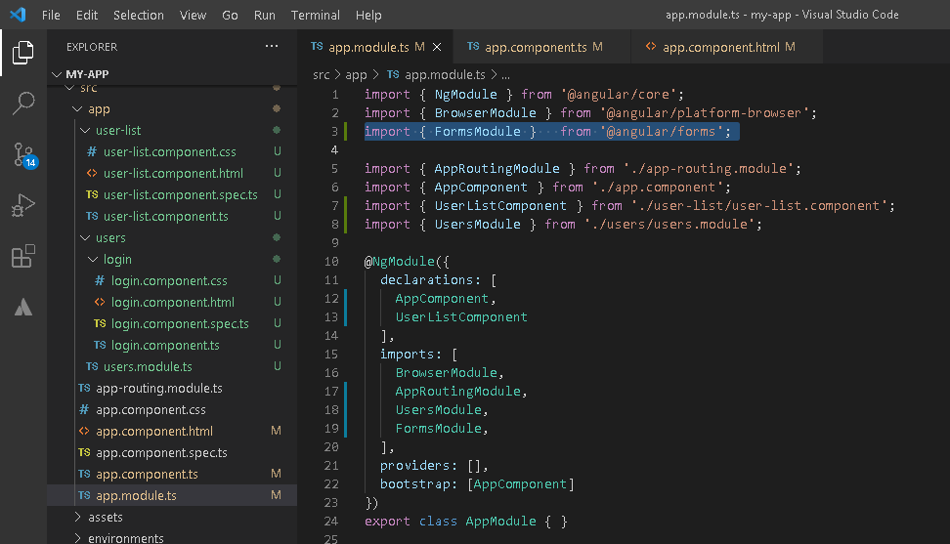
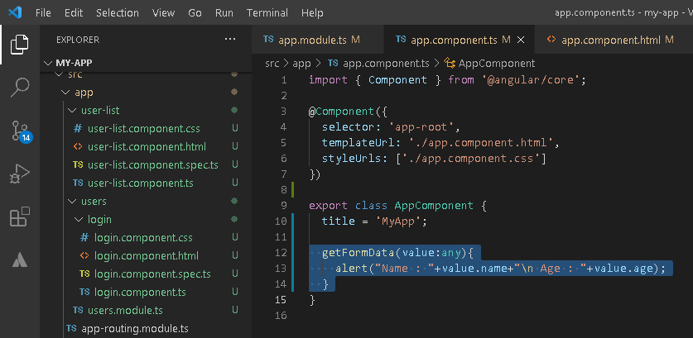
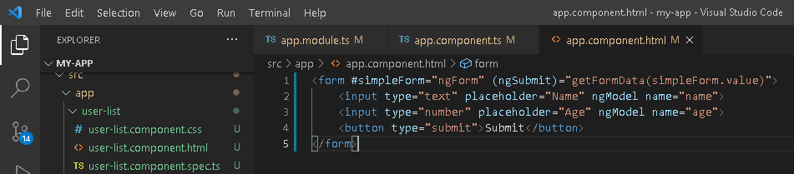
NgForm
npm i @angular/forms

Slide 15
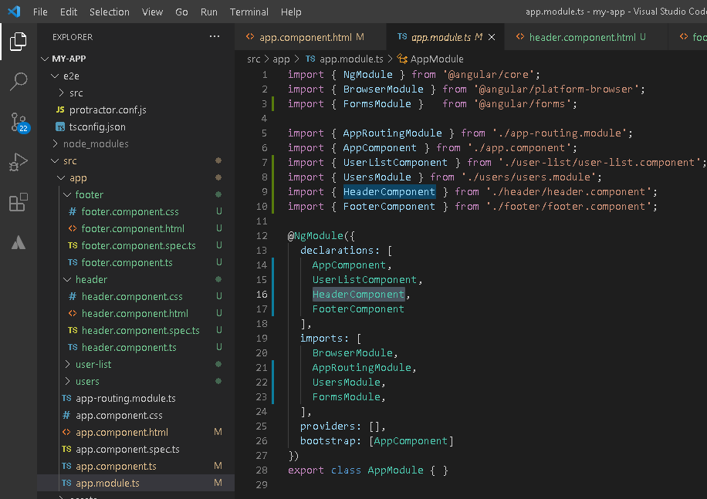
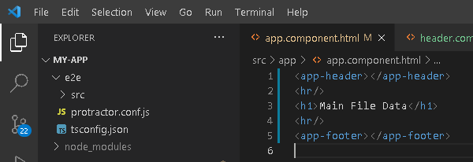
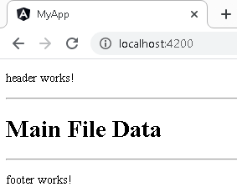
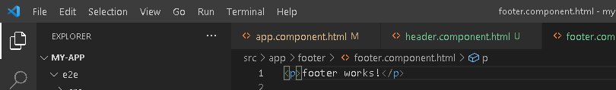
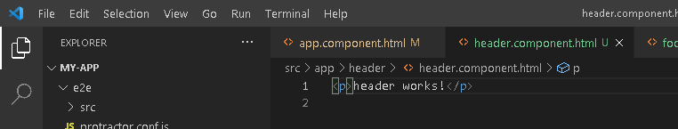
Header – Footer – Main File
ng g c header
ng g c footer

Slide 16
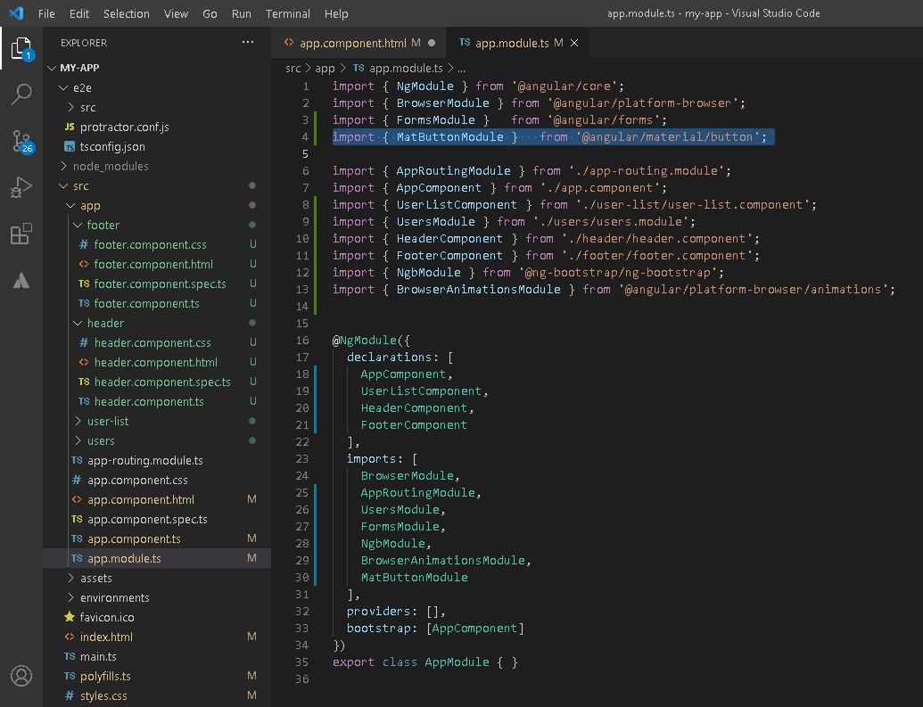
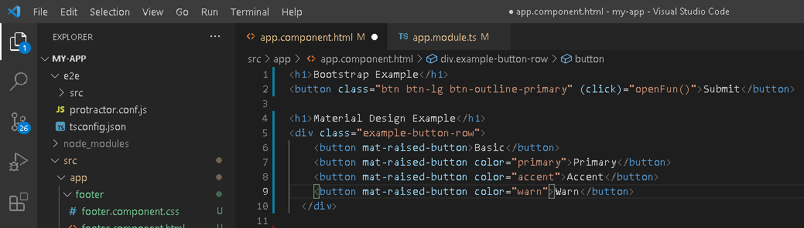
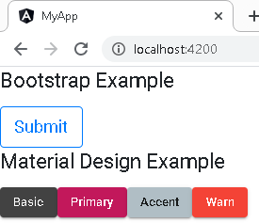
Bootstrap & Material Design
ng add @ng-bootstrap/ng-bootstrap
ng add @angular/material
https://ng-bootstrap.github.io/#/components/buttons/examples
https://material.angular.io/components/categories

Slide 17
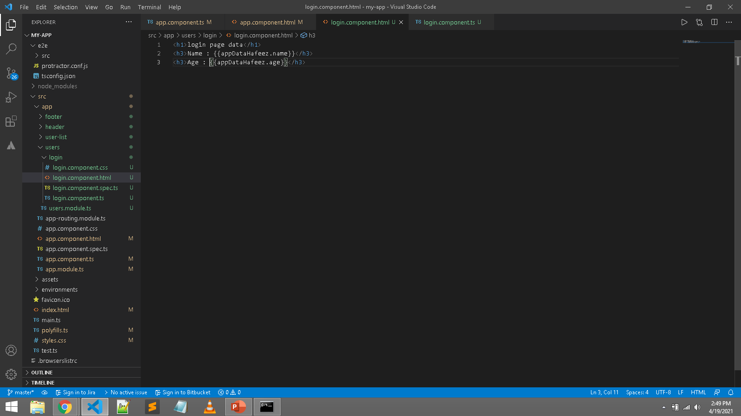
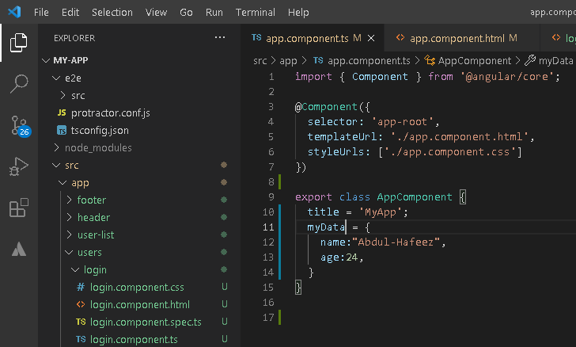
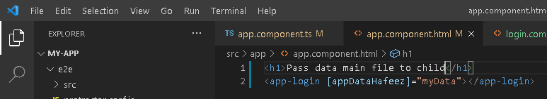
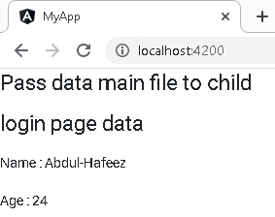
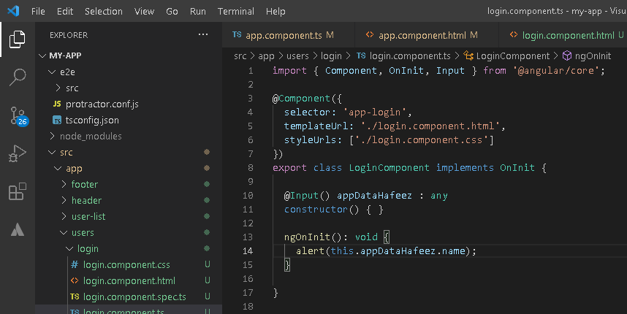
Pass data parent to child

Slide 18
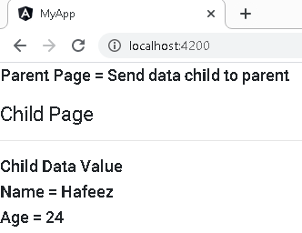
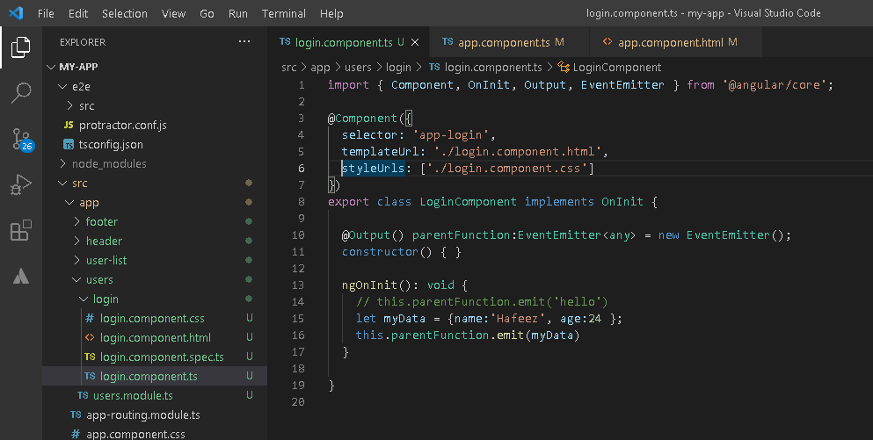
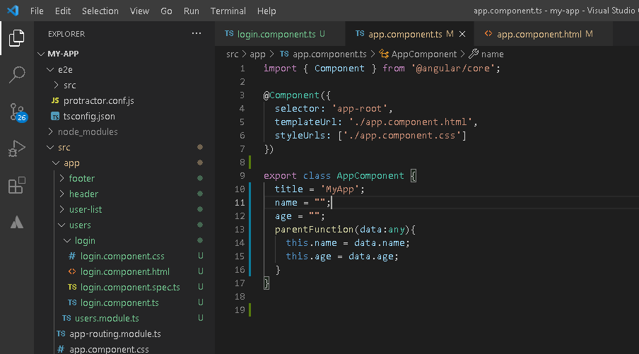
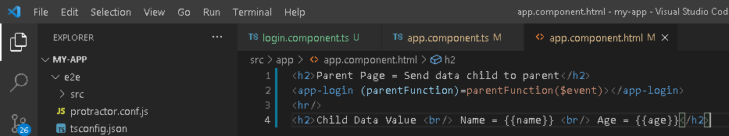
Parent Function call from child

Slide 19
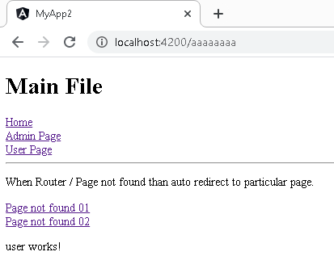
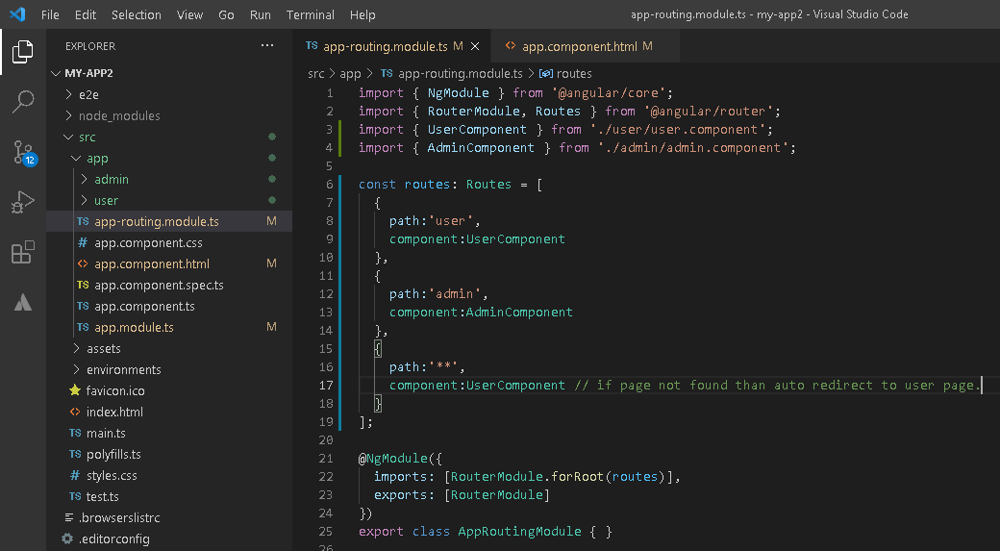
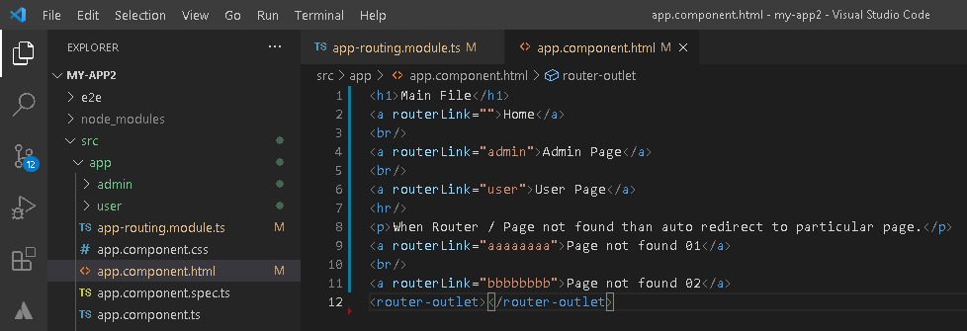
Routing = Mean (Nav)
ng g c user
ng g c admin

Slide 20
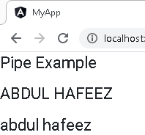
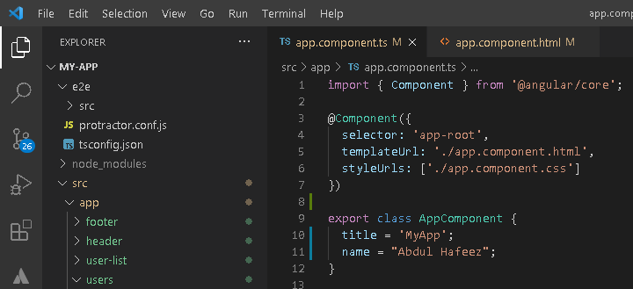
Angular Pipe
<h1>Pipe Example</h1>
<h1>{{ name | uppercase }}</h1>
<h1>{{ name | lowercase }}</h1>

Slide 21
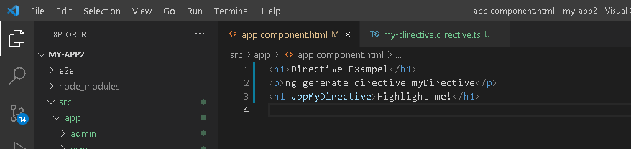
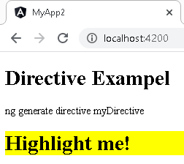
Directive – Add Dynamic Style
<h1>Directive Exampel</h1>
<p>ng generate directive myDirective</p>
<h1 appMyDirective>Highlight me1!</h1>
<h1 appMyDirective>Highlight me2!</h1>
ng generate directive myDirective

Slide 22
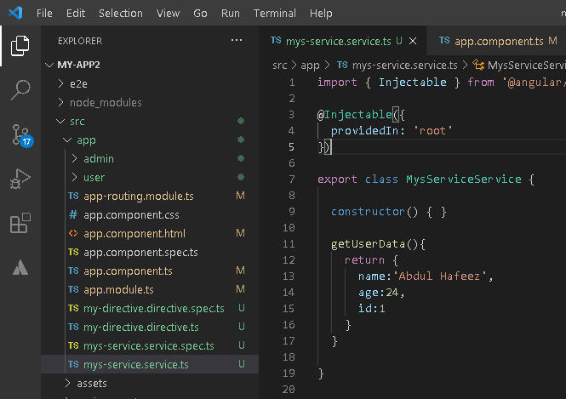



Service – Like Class define multi functions
ng generate service myService

Slide 23





Service – Api Call
ng generate service myService
https://jsonplaceholder.typicode.com/todos/

Slide 24





Lazy Loading Routing – Avoid to load all pages. (Making Fast App)
ng g m admin --routing
ng g c admin/login
ng g c admin/list
ng g m user --routing
ng g c user/login
ng g c user/list

Slide 25



Lazy Loading Components – Avoid to load all component. (Making Fast App)

